Slide 1
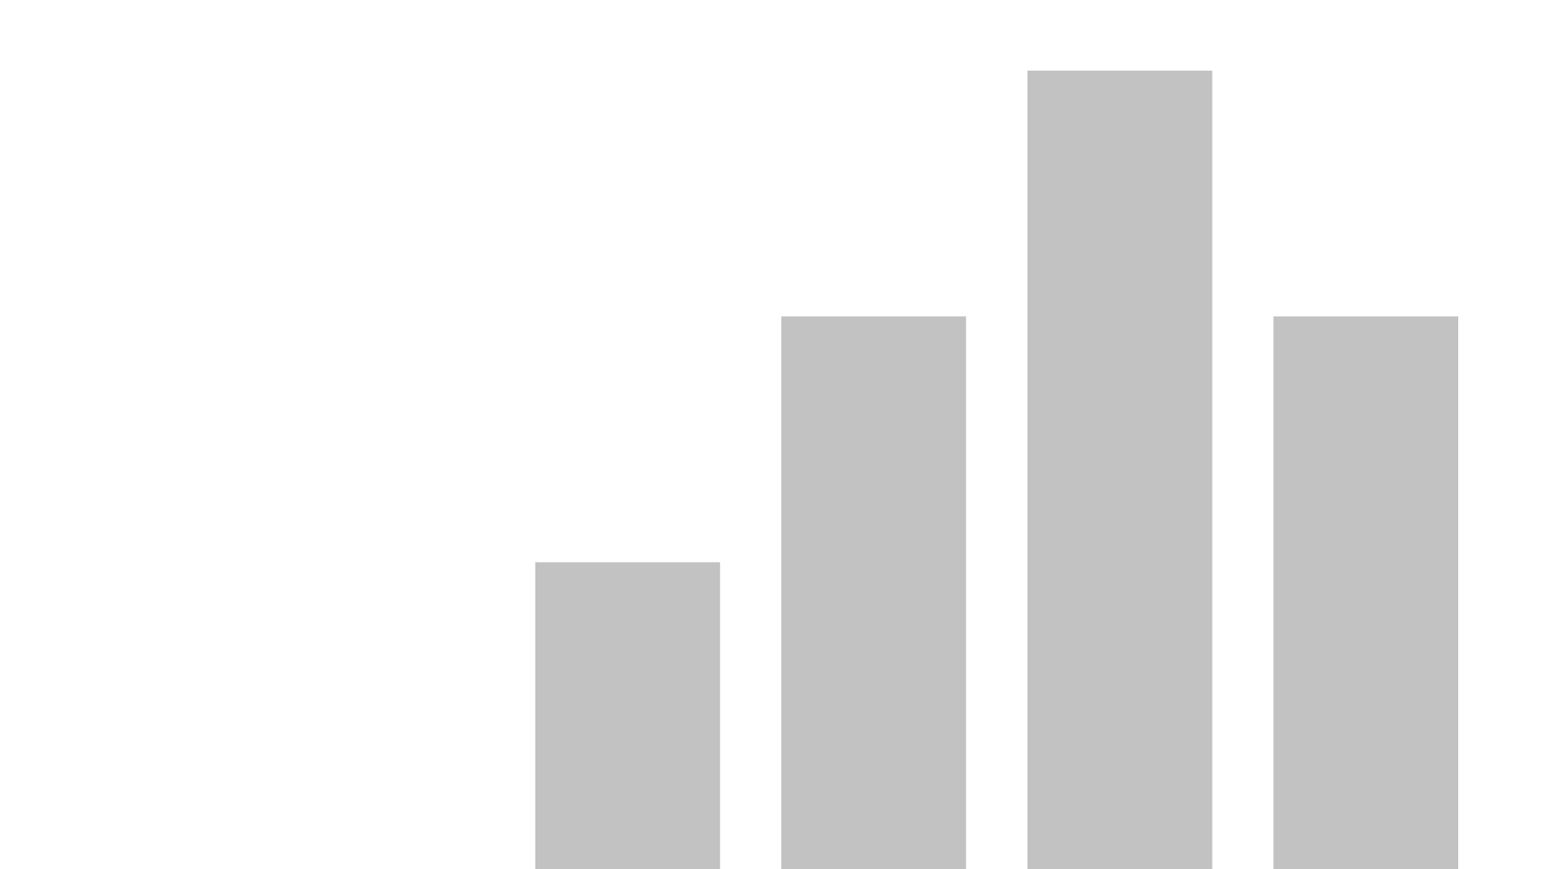


B2B Sales Analysis report
View in Power BI
Last data refresh:
15/09/2021 09:00:09 UTC
Downloaded at:
15/09/2021 09:04:03 UTC

Slide 2
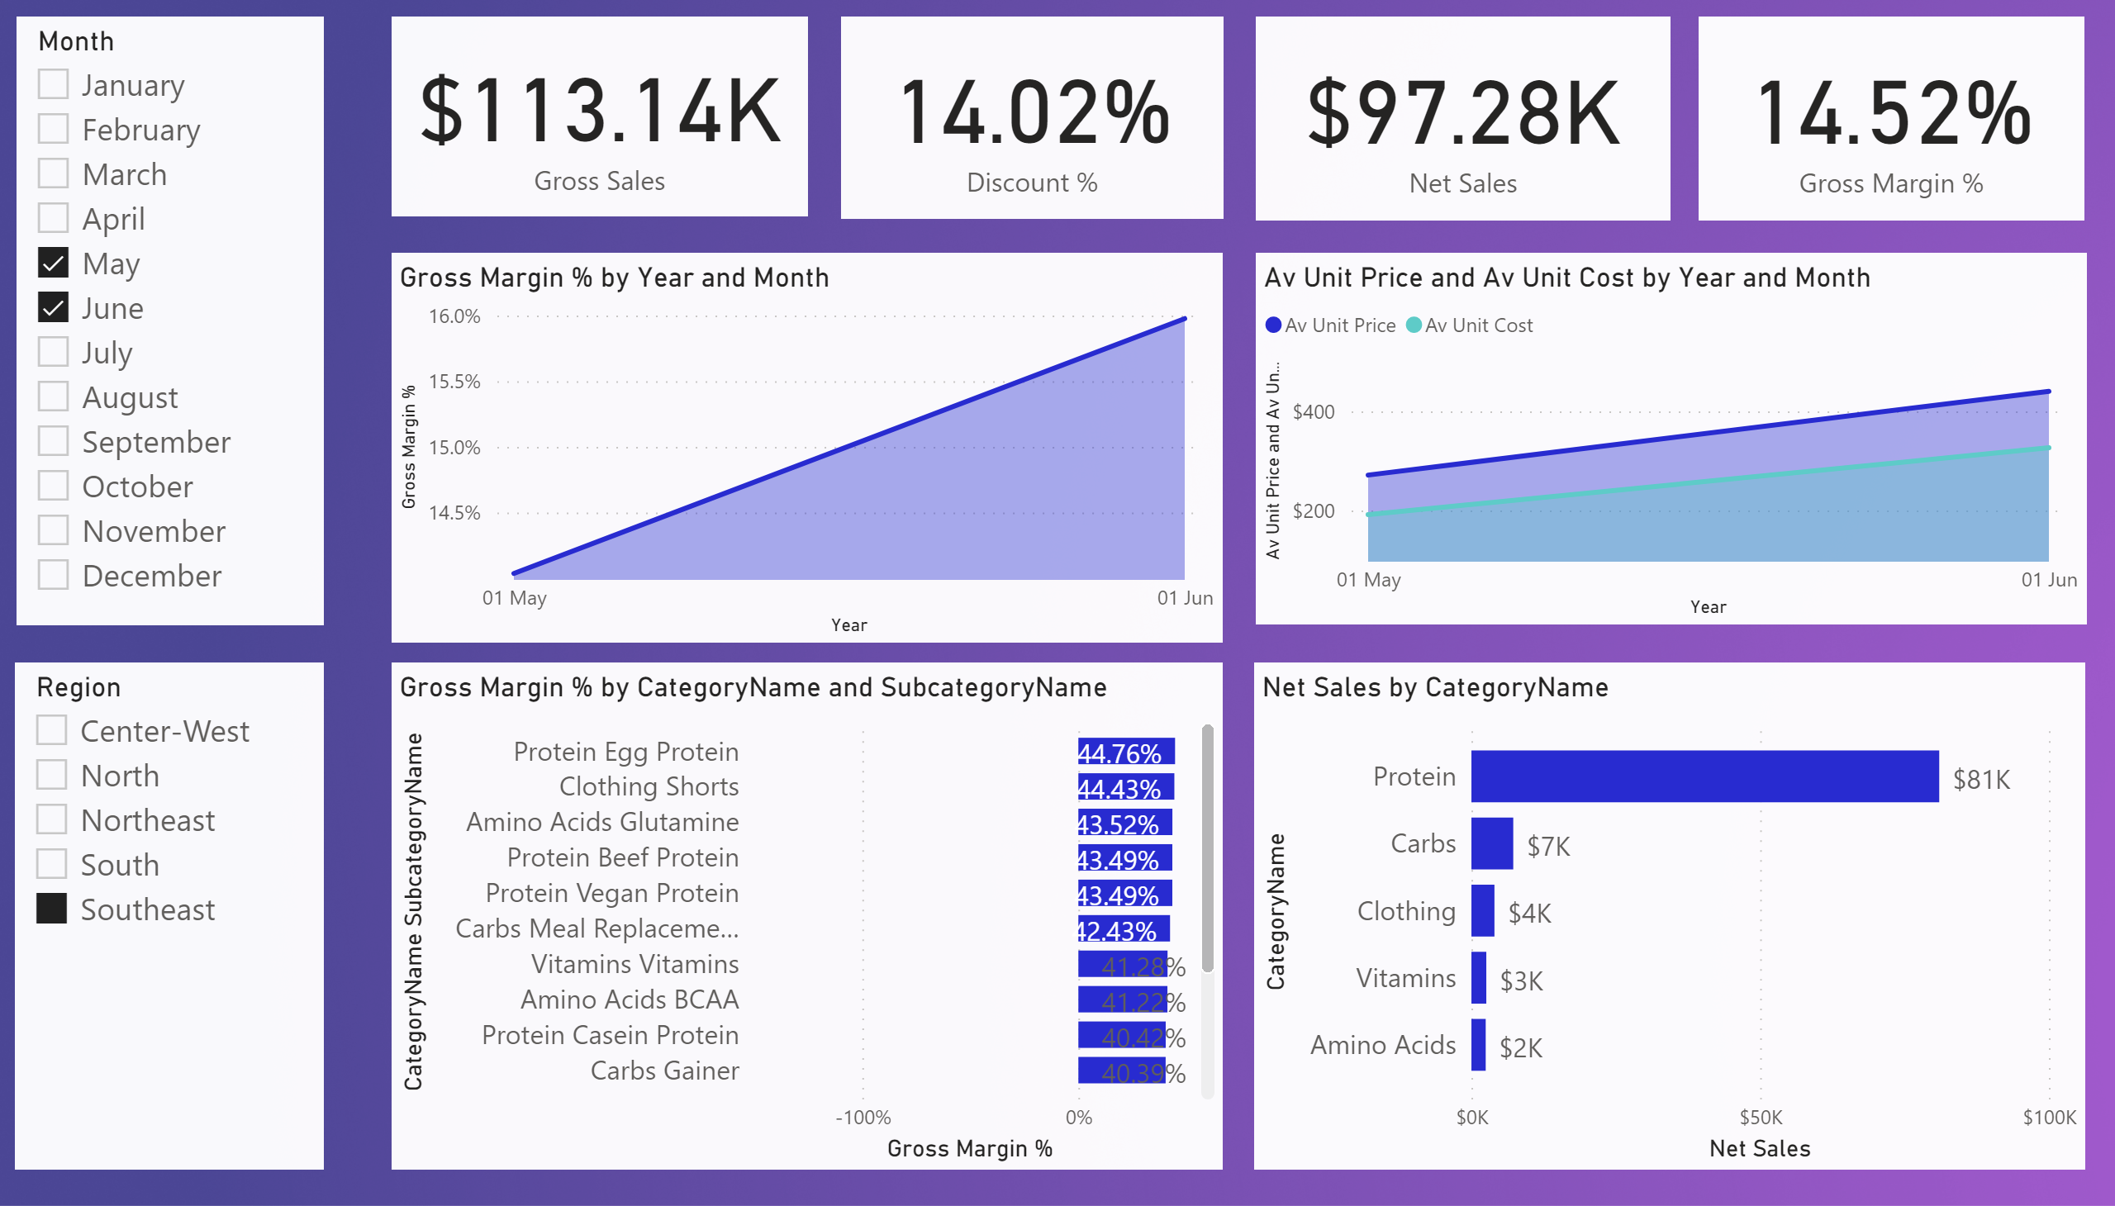
Page 1
Notes:
card
No alt text provided.
card
No alt text provided.
barChart
No alt text provided.
card
No alt text provided.
card
No alt text provided.
areaChart
No alt text provided.
slicer
No alt text provided.
slicer
No alt text provided.
areaChart
No alt text provided.
barChart
No alt text provided.

Slide 3
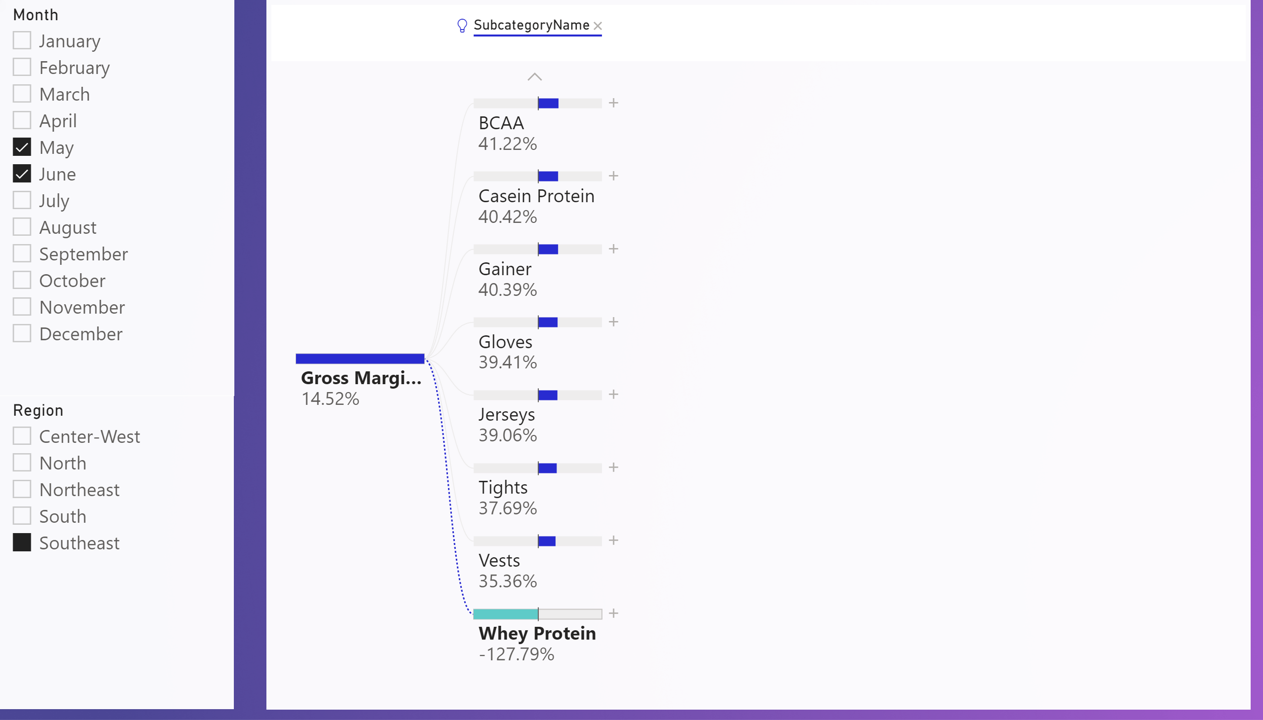
Page 2
Notes:
slicer
No alt text provided.
slicer
No alt text provided.
decompositionTreeVisual
No alt text provided.

Slide 4
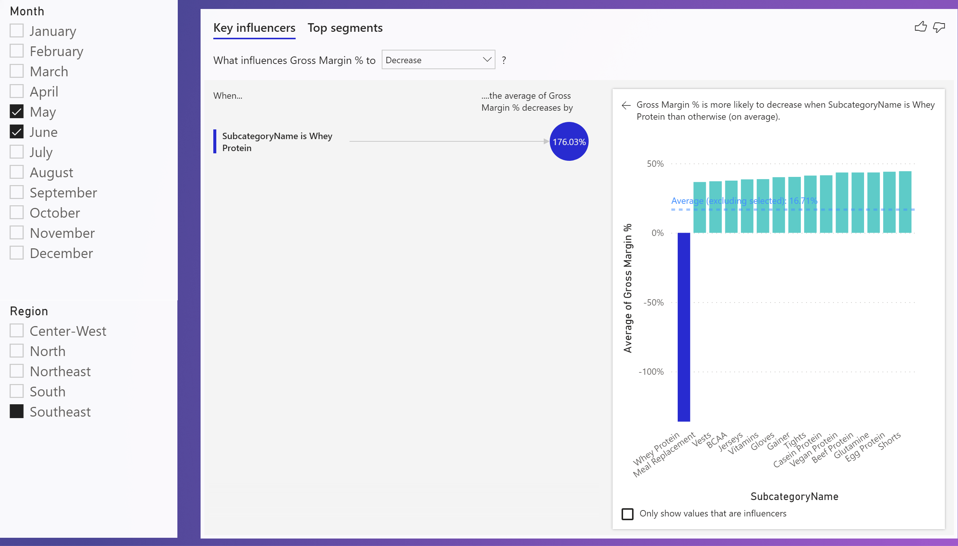
Page 3
Notes:
slicer
No alt text provided.
slicer
No alt text provided.
keyDriversVisual
No alt text provided.

Slide 5
B2B SALES ANALYSIS REPORT
There was a drastic drop in the gross margin percent (14.52%) in the month of may,June 2013 in the south eastern region,the sub category egg protein (44.76%) had the highest discount % at this time, with Amino Acid(41.34%) as the highest category Name..The city Belo Horizonte(47.64%) ,Supplement store (47.64%),protein(47.64%),5lbs(47.64%)are the city name,business type,category name,product size that has the highest sales despite the drop in the gross margin.
This decrease is caused by the little difference between the the average unit price and the average unit cost
Comparing this with the highest gross margin % ,there was a drastic increase in the gross margin (78.4% )in September and November 2013 in the south eastern region with egg protein (85.83%) has the highest as the highest category Name..The city Belo Horizonte(85.92%) ,Supplement store (85.92%),protein(85.92%),5lbs(85.92%)are the city name,business type,category name,product size
RECOMMENDATION
There is need to increase the average unit cost by more than 100 percent of the unit price to get an increase in percentage gross margin.

